Slide 1


Slide 2
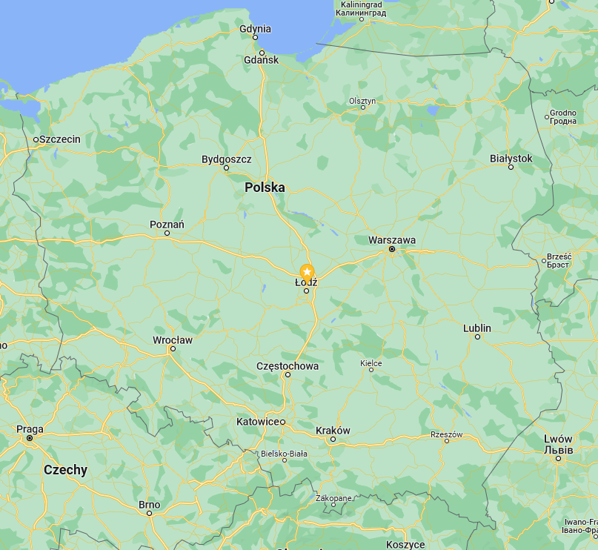

Slide 3
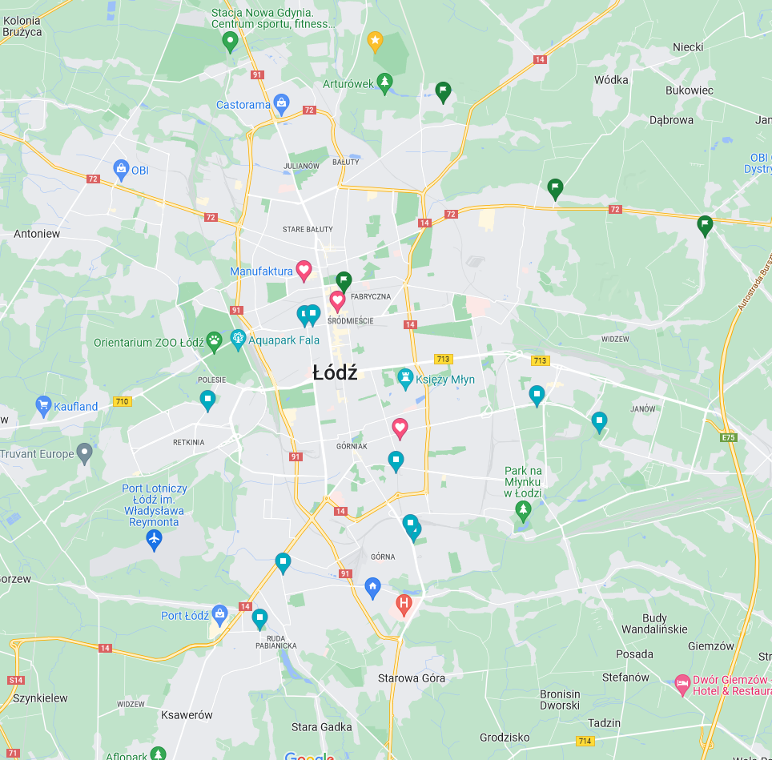

Slide 4


Slide 5
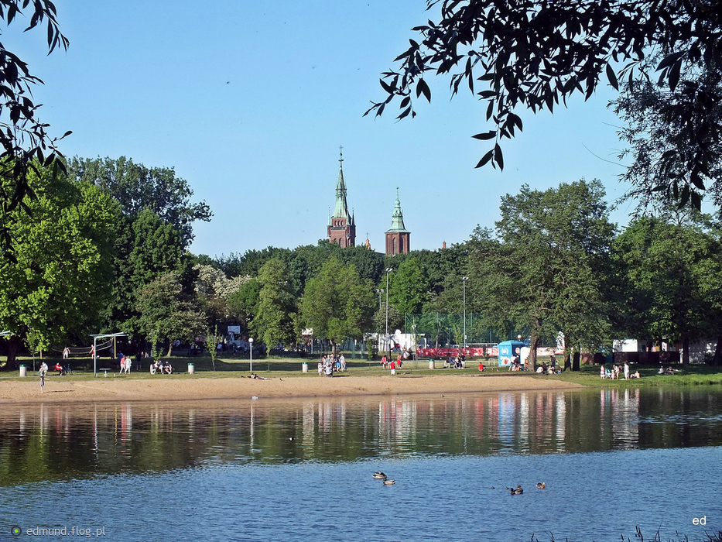

Slide 6


Slide 7


Slide 8


Slide 9
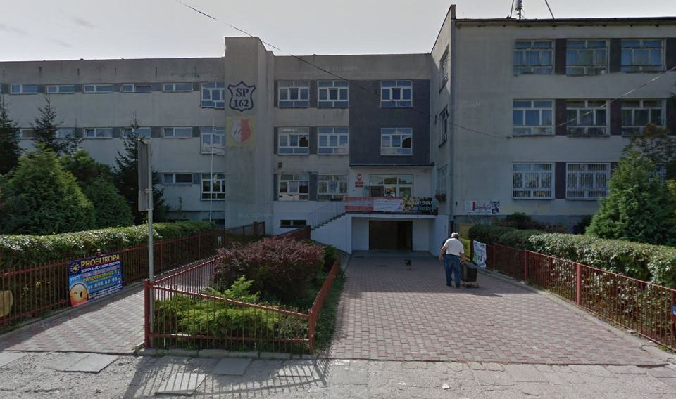


Slide 10
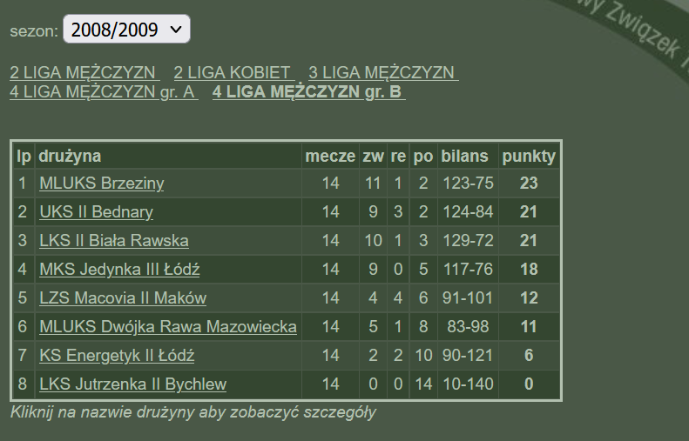

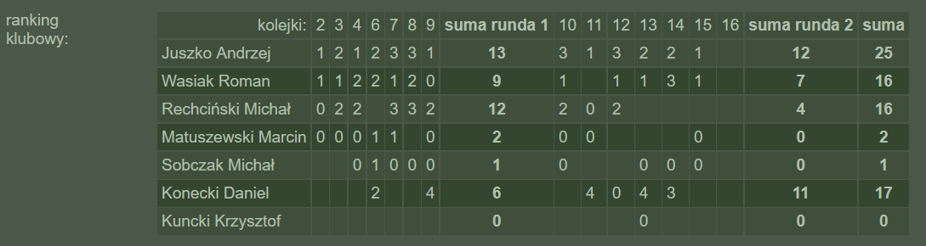

Slide 11



Mathematics
(Bachelor’s & Master’s degree)
Banking and digital finance
(nothing)
Academy of analysts – programming in R, SAS & Python
(post-graduate studies)

Slide 12

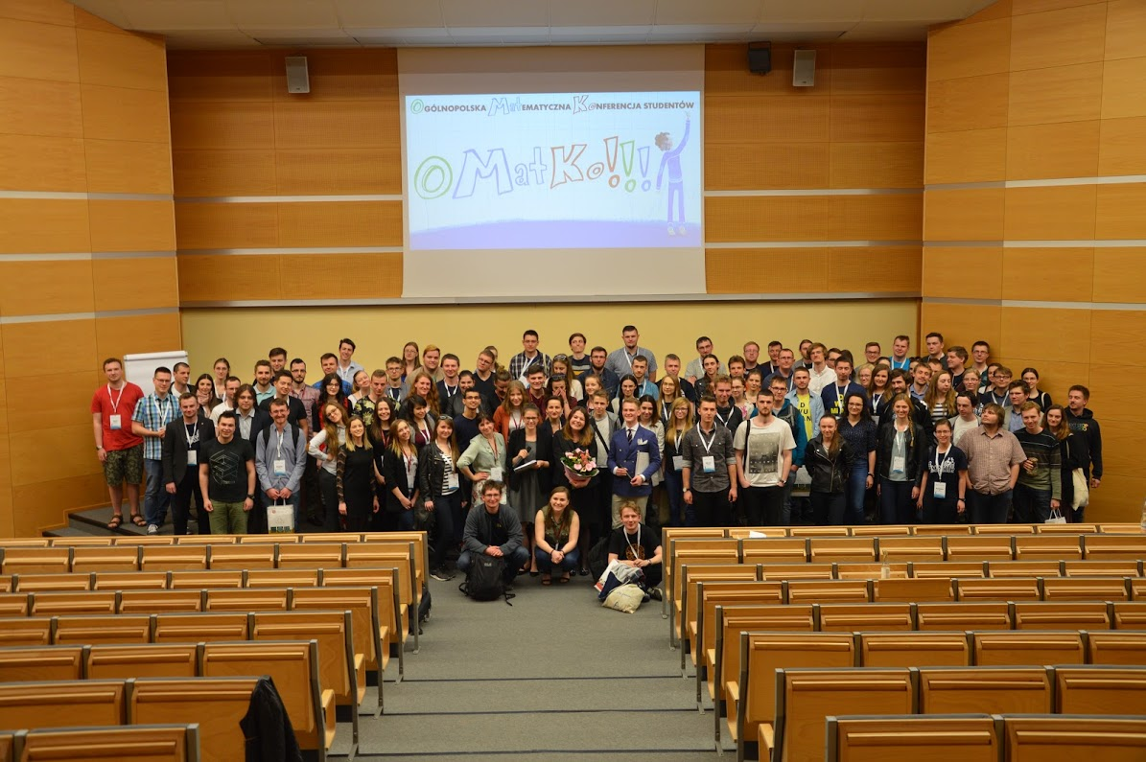

Slide 13



Slide 14


Slide 15


Slide 16


Slide 17
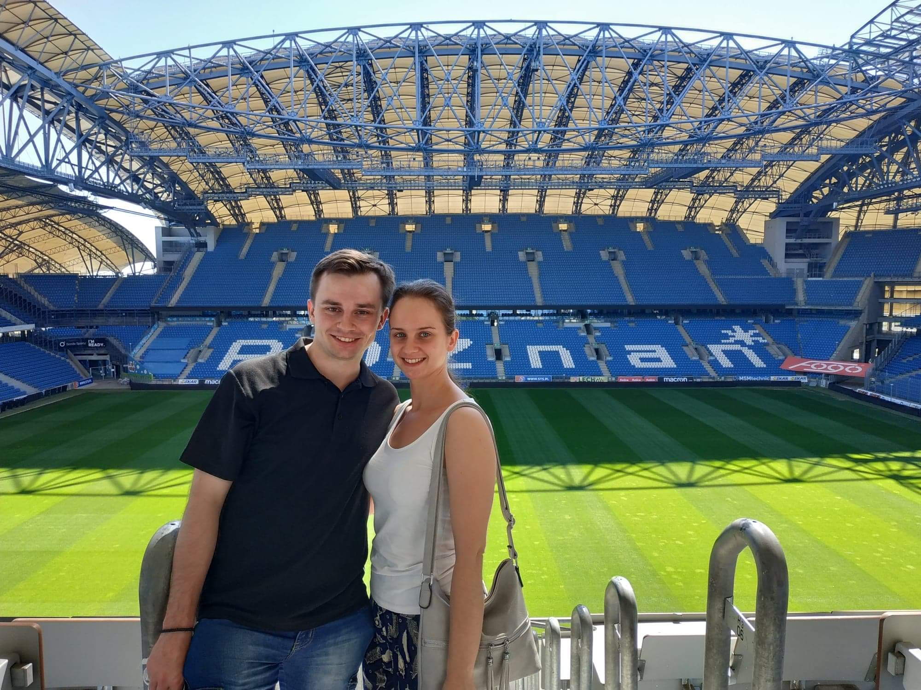

Slide 18
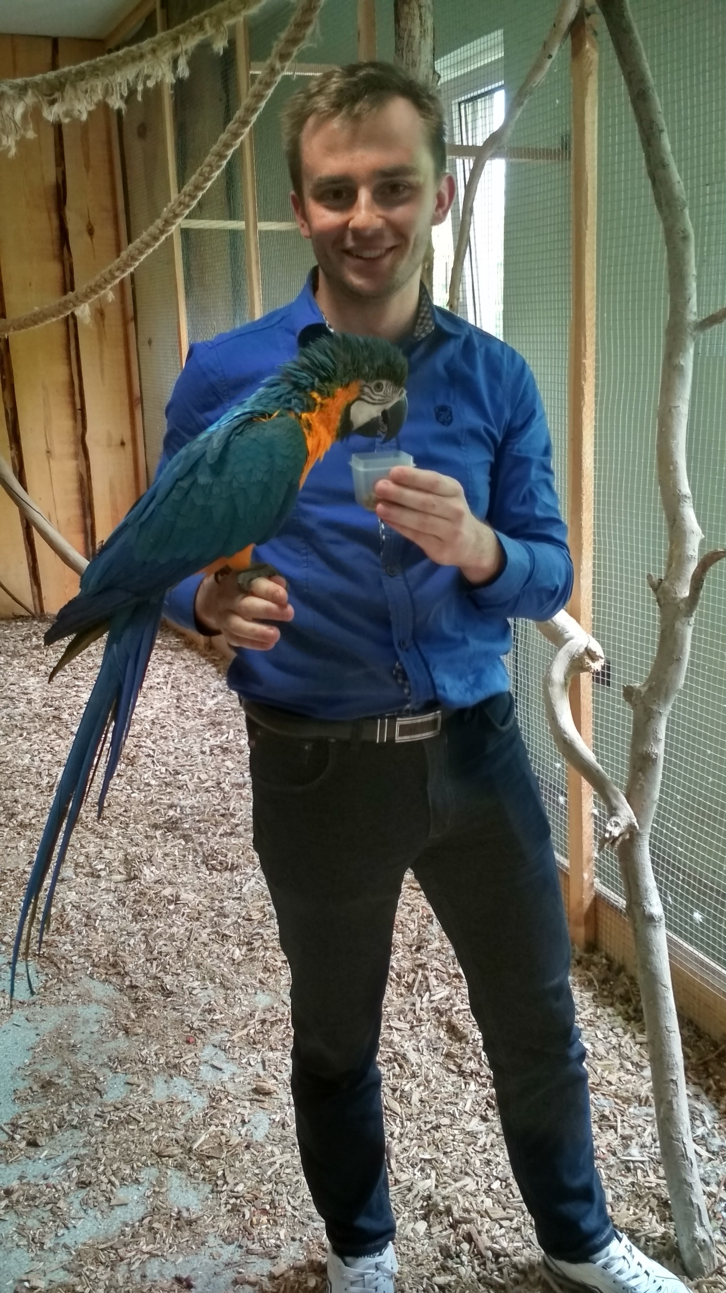


Slide 19








Slide 20

introvert
modest
traditional
sentimental
taciturn

